Slide 1




NEXT GEN EMPLOYABILITY PROGRAM
Creating a future-ready workforce
Team Members
College Name
Student Name :Fagurudeen S
Student ID : au623521104015
AVS COLLEGE OF TECHNOLOGY

Slide 2

CAPSTONE PROJECT SHOWCASE
Project Title
Building Bus Reservation System using Python and Django
Abstract | Problem Statement | Project Overview | Proposed Solution | Technology Used | Modelling & Results | Conclusion

Slide 3
Abstract
The Bus Reservation System (BRS) is a web-based application developed using Python and Django framework.
Aimed at facilitating the booking and management of bus tickets, providing convenience and efficiency to users.
Key features include user registration/authentication, bus and route management, seat reservation, payment integration, and reservation management.
Source :

Slide 4
Problem Statement
The Bus Reservation System (BRS) is a web-based application developed using Python and Django framework.
Aimed at facilitating the booking and management of bus tickets, providing convenience and efficiency to users.
Key features include user registration/authentication, bus and route management, seat reservation, payment integration, and reservation management.
Source :

Slide 5
Project Overview
The Bus Reservation System (BRS) is a web-based application developed using Python and Django framework.
Aimed at facilitating the booking and management of bus tickets, providing convenience and efficiency to users.
Key features include user registration/authentication, bus and route management, seat reservation, payment integration, and reservation management.
Source :

Slide 6
Proposed Solution
The Bus Reservation System (BRS) is a web-based application developed using Python and Django framework.
Aimed at facilitating the booking and management of bus tickets, providing convenience and efficiency to users.
Key features include user registration/authentication, bus and route management, seat reservation, payment integration, and reservation management.
Source :

Slide 7
DEVELOPMENT PROCESS:
The Bus Reservation System (BRS) is a web-based application developed using Python and Django framework.
Aimed at facilitating the booking and management of bus tickets, providing convenience and efficiency to users.
Key features include user registration/authentication, bus and route management, seat reservation, payment integration, and reservation management.
Source :

Slide 8


Technology Used
Front-end
Back-end
Source :

Slide 9
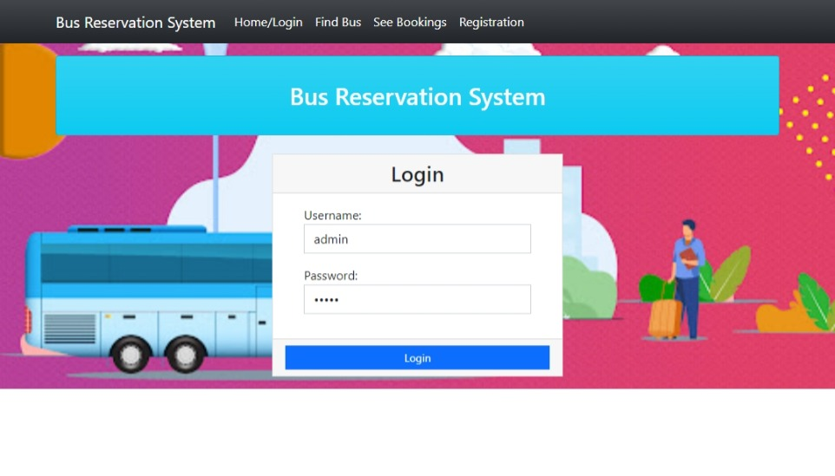
Homepage
LOGIN PAGE
BOOKINGS
REGISTRATION
FIND BUS
TICKETS DETAILS

Slide 10
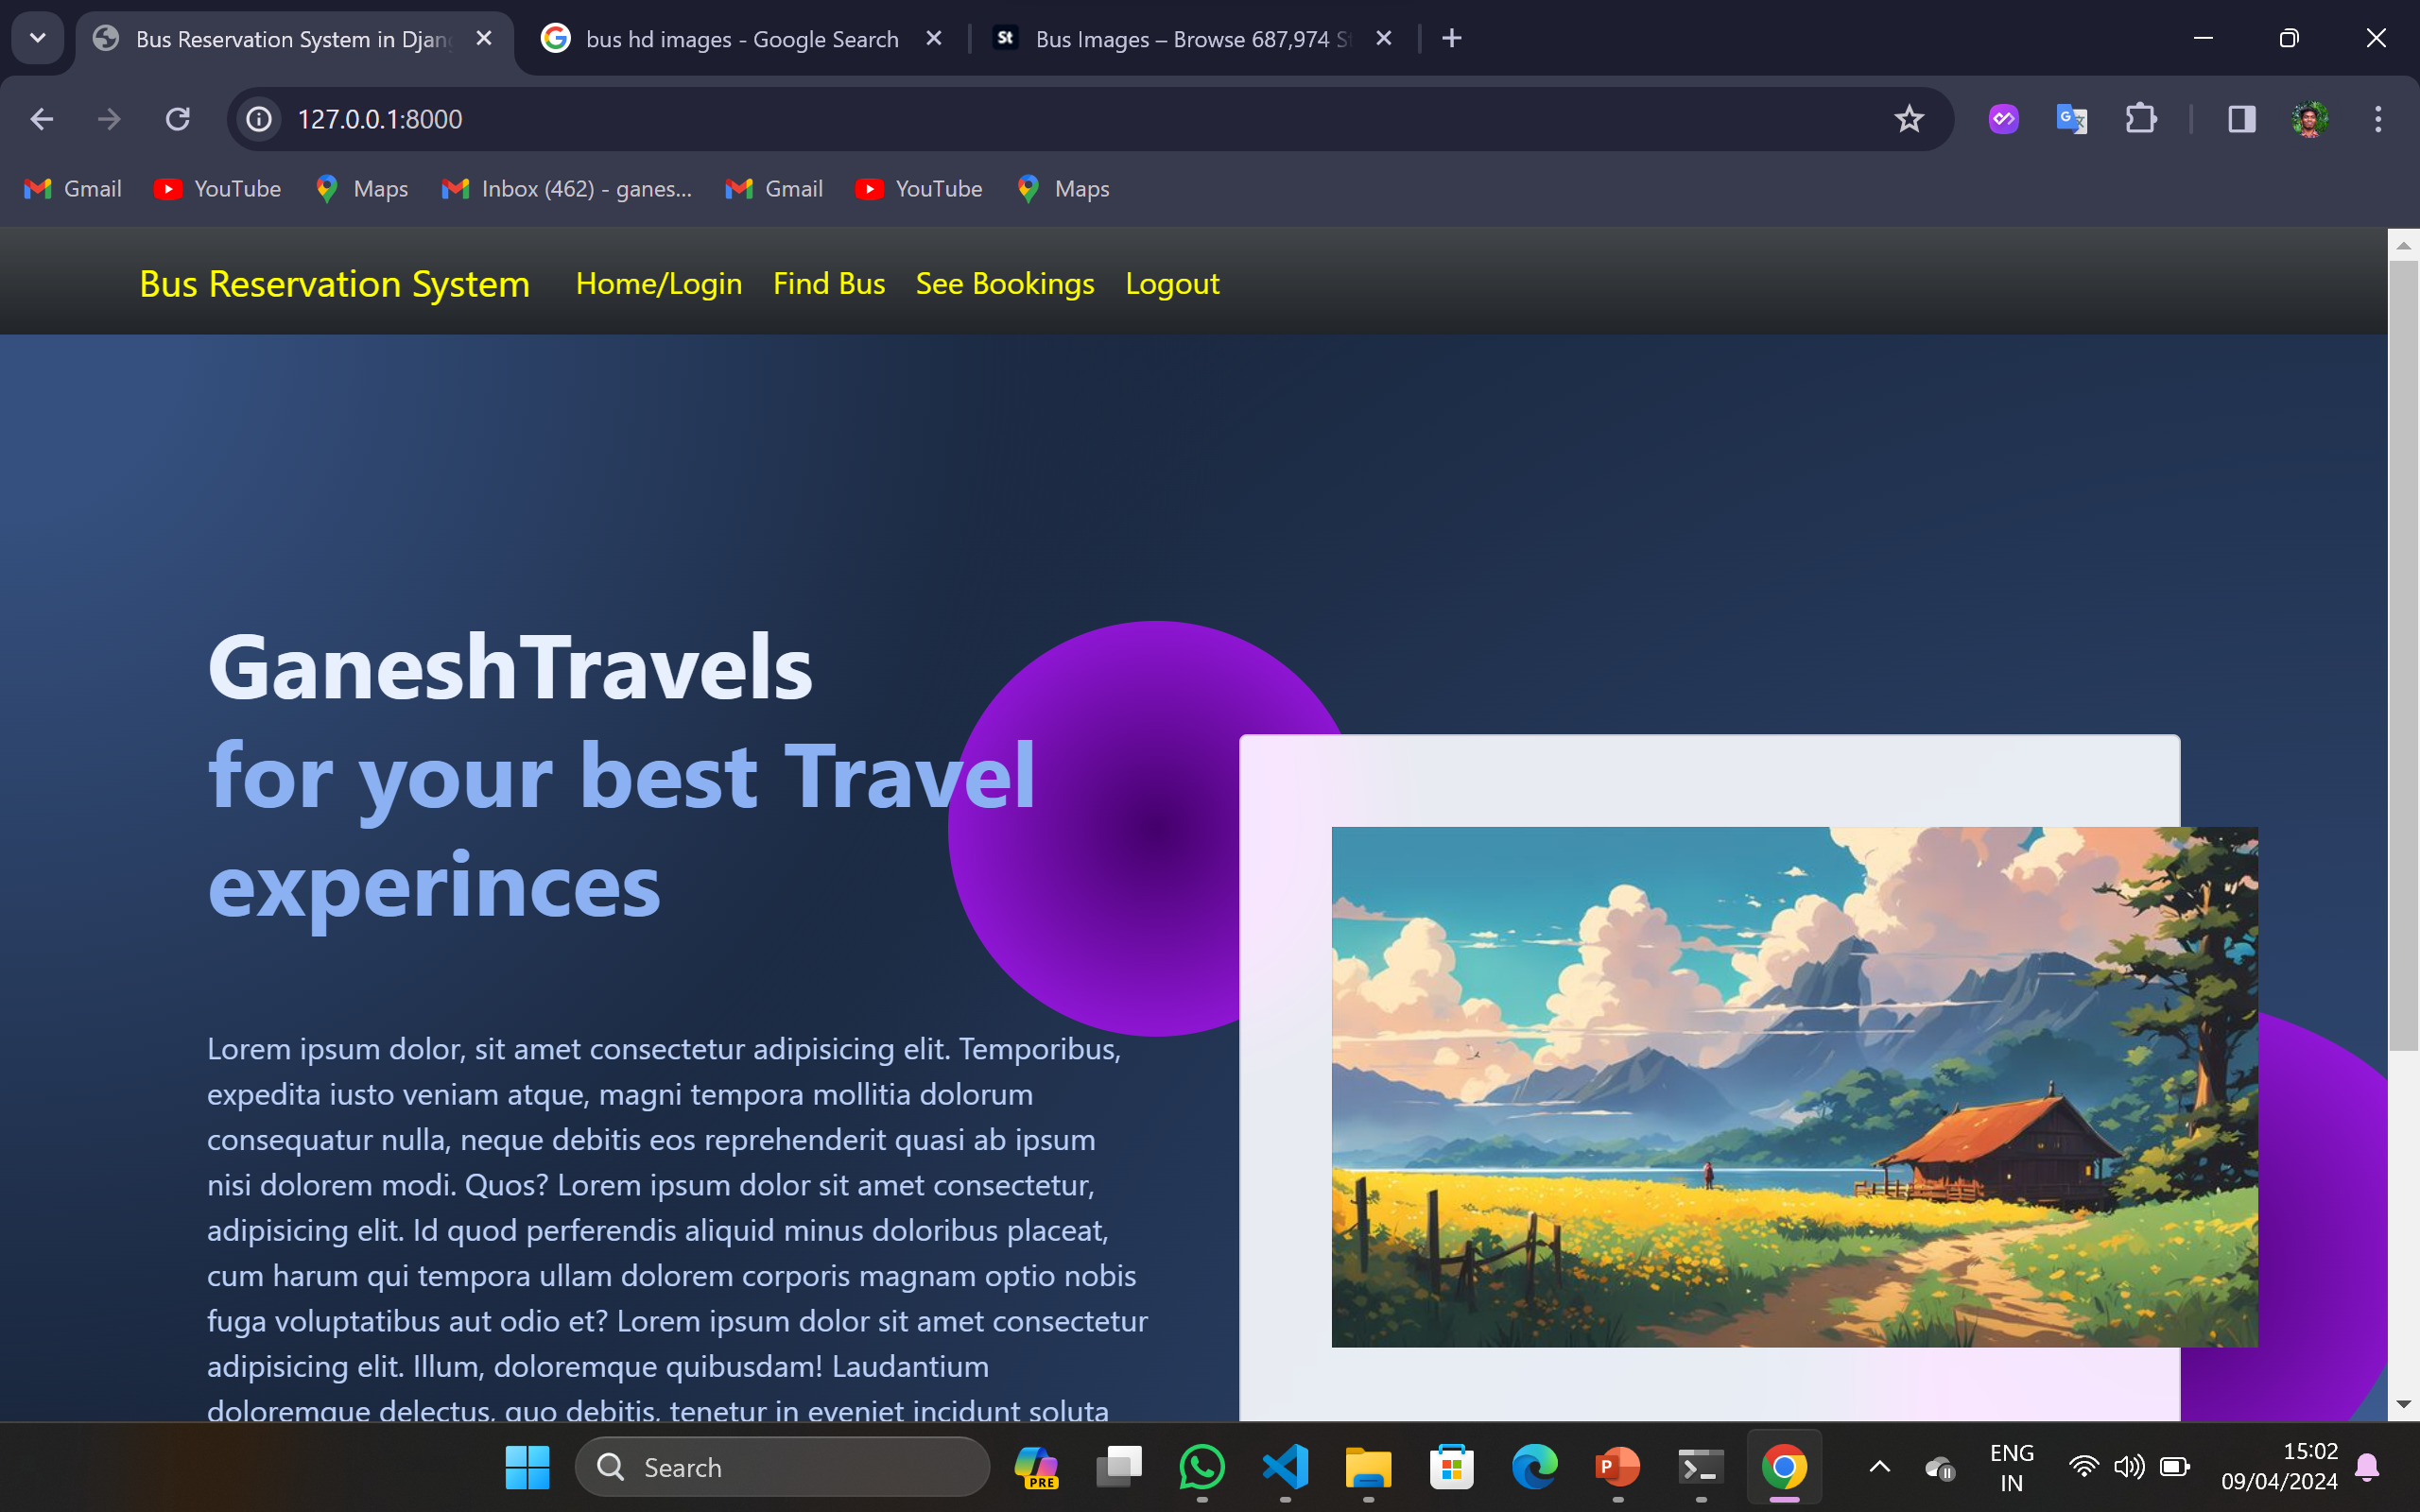
About-Us-Page

Slide 11
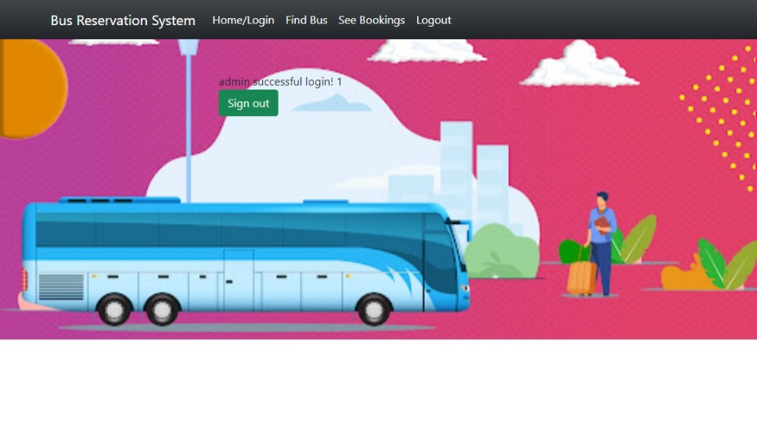
Service-Page

Slide 12
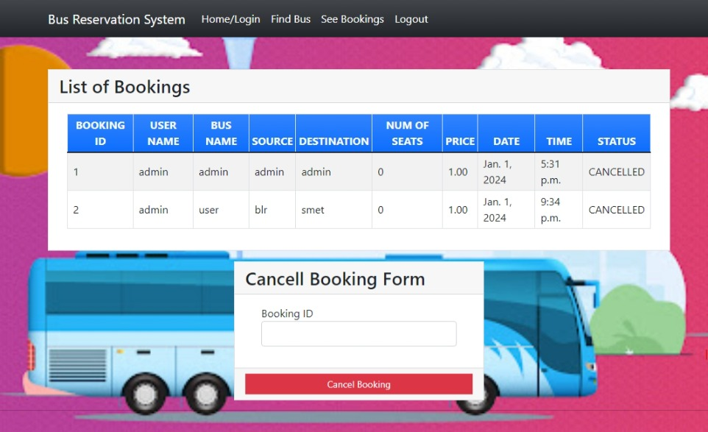
Departments-Page

Slide 13
Future Enhancements:
Develop a dedicated mobile application for bus ticket booking.
Integrate real-time updates for bus schedules and seat availability.
Enhance the admin dashboard with advanced analytics tools.
Implement dynamic pricing algorithms based on demand.
Enable support for multiple languages.

Slide 14
Conclusion
Develop a dedicated mobile application for bus ticket booking.
Integrate real-time updates for bus schedules and seat availability.
Enhance the admin dashboard with advanced analytics tools.
Implement dynamic pricing algorithms based on demand.
Enable support for multiple languages.
Source :

Slide 15
Thank You!
Notes:
Thank You !!

